Slide 1

Analyzing Amazon Sales Data
By Kalpesh Deshpande

Slide 2

Overview
In the competitive landscape of e-commerce, effective sales management is crucial for optimizing distribution methods, reducing costs, and maximizing profits. By analyzing sales trends, businesses can gain valuable insights into customer behavior, seasonal patterns, and overall sales performance.
This project focuses on extracting, transforming, and loading (ETL) an Amazon sales dataset to analyze sales trends month-wise, year-wise, and year-by-month.

Slide 3
Tools and Libraries
- Python: For data extraction, transformation, and loading.
- Pandas: For data manipulation and analysis.
- NumPy: For numerical computations.
- Matplotlib: For creating static visualizations.
- Seaborn: For enhanced data visualization, including heatmaps and trend lines.

Slide 4
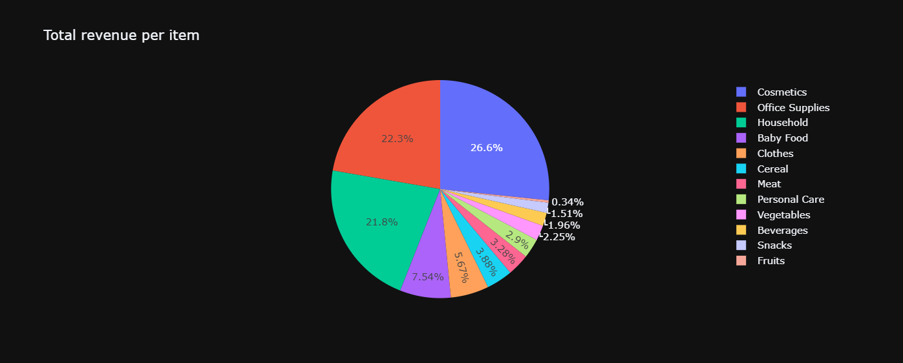
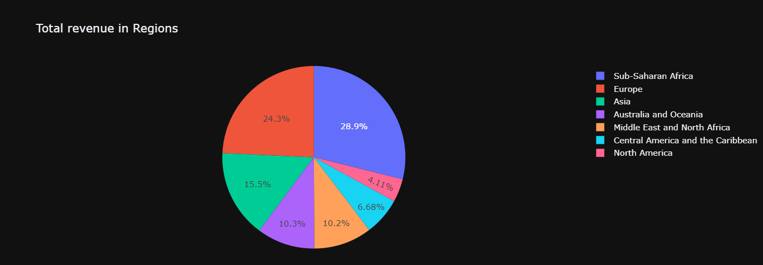

Slide 5
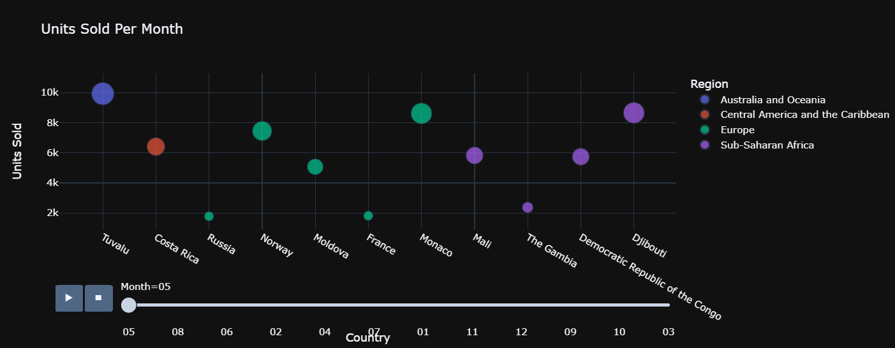

Slide 6
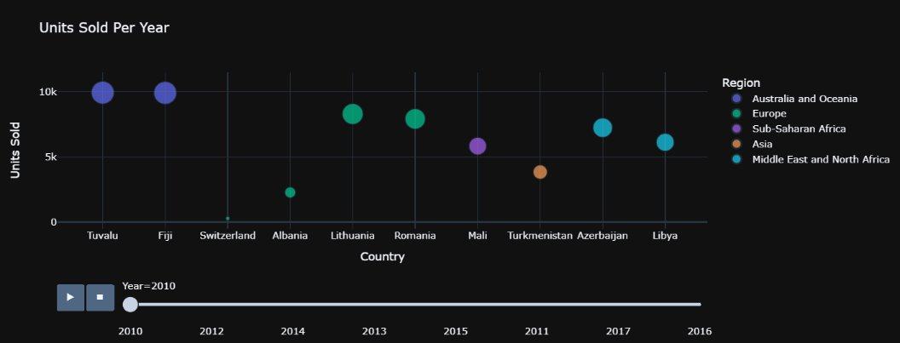

Slide 7
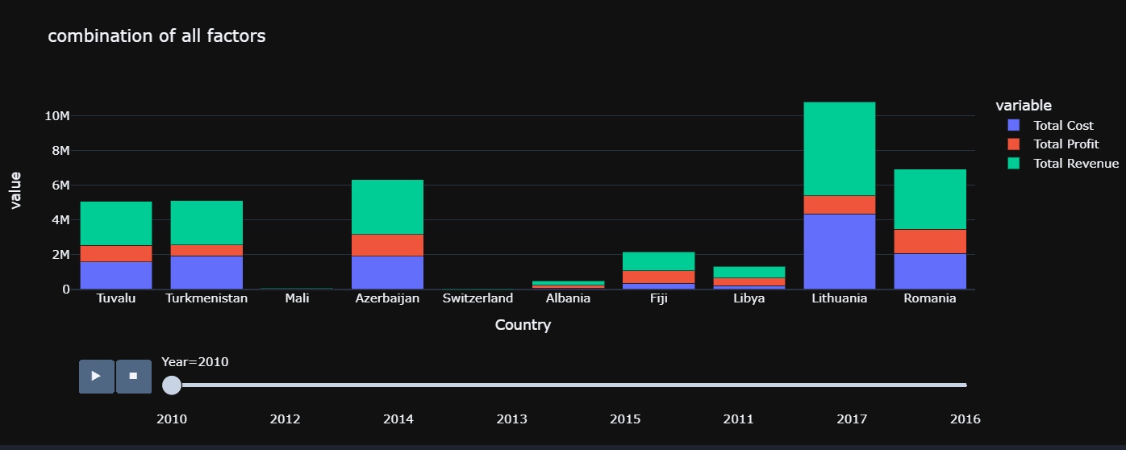

Slide 8
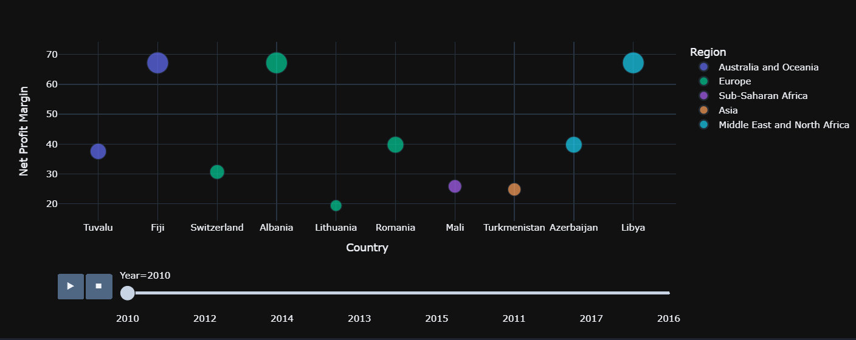
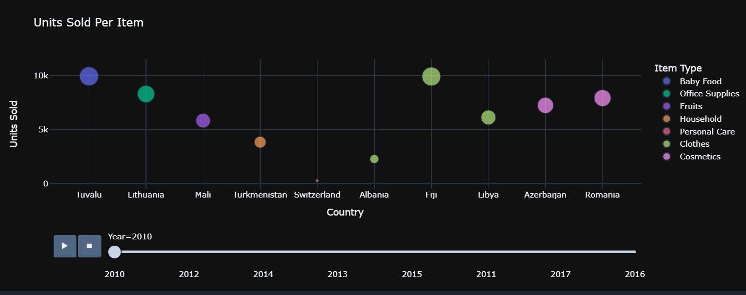

Slide 9
Thank you

